Slide 1
Chapter 2

Slide 2
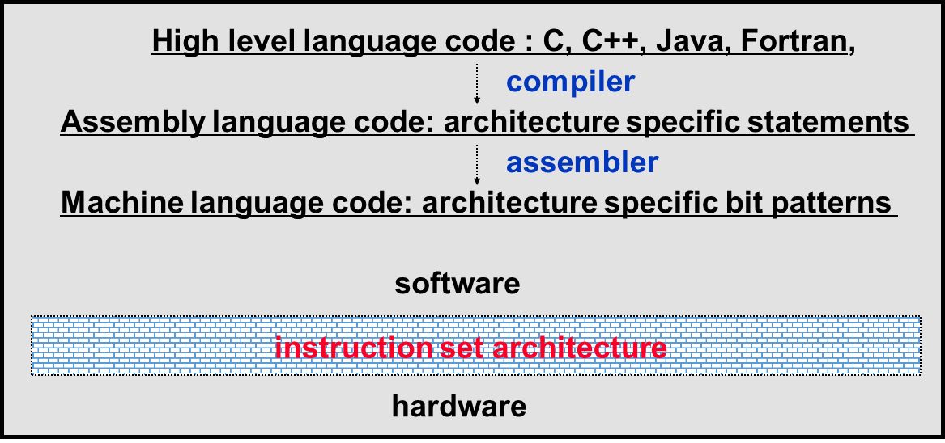
introduction
Stored-program concept: The idea that instructions and data of many types can be stored in memory as numbers, leading to the stored-program computer.
Instruction set: The vocabulary of commands understood by a given architecture.
Instruction Set Architecture (ISA)
It’s an interface between software and hardware.
It’s a mechanism by which the software tells the hardware what should be done.

Slide 3
Operations of the computer hardware
The C language statement,
instructs a computer to add the two variables b and c and to put their sum in a.
In MIPS assembly language notation,
instructs a computer to add the two values of the two registers b and c and to put their sum in register a.
a = b + c
add a, b, c
The C language statement,
instructs a computer to subtract the value of e variable from variable a and assign the result to variable d.
In MIPS assembly language notation,
instructs a computer to subtract the content of register e from register a and to put the result in register d.
d = a - e
sub d, a, e
Refer participation activities 2.2.5 in zybooks for more MIPS programming examples

Slide 4
Question: To place the sum of four variables namely b,c,d,e in variable a, how could the sequence of instructions be written in MIPS assembly language?
Hint : Every instruction can have 2 operands and one destination to store the result.
Answer in MIPs assembly language :
add a, b, c # Sum of b and c is placed in a
add a, a, d # Sum of b, c and d is placed in a
add a, a, e # Sum of b, c, d and e is now in a
The answer for the above question could be written in C language as,
a= b + c + d + e

Slide 5
Translating a C statement into MiPS
A C language statement contains the five variables f, g, h, i, and j:
f = (g + h) – (i + j);
Translate the above C statement to MIPS and write down the translated MIPS instructions.
Note : Use two temporary variables called t0 and t1 to hold the partial results of the 2 additions in the above statement.
Refer participation activities 2.2.6 in zybooks for this MIPS programming example

Slide 6
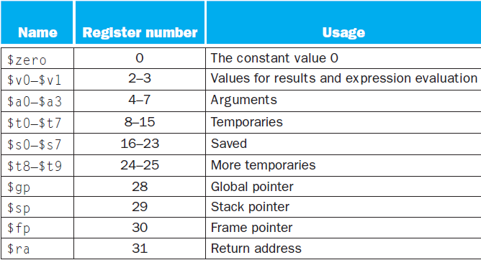
Registers used in MIPS

Slide 7
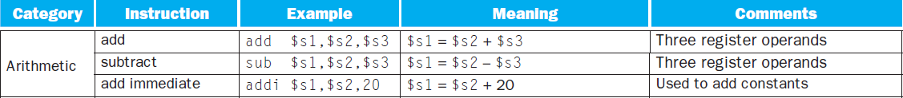
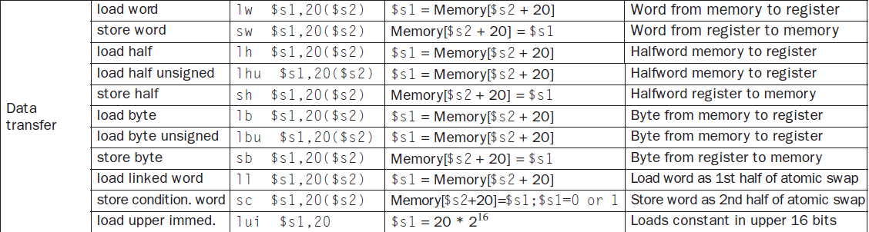
MIPs assembly language instructions

Slide 8
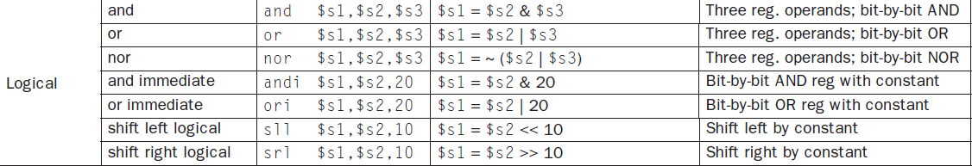
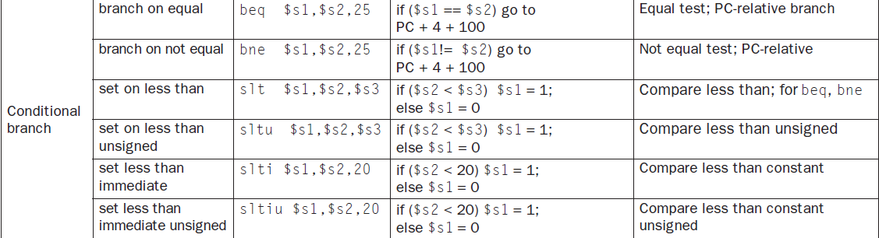
MIPs assembly language instructions contd…

Slide 9
Memory operands
Data transfer instruction: A command that moves data between memory and registers.
Address : A value used to delineate the location of a specific data element within a memory array.
The size of a register in the MIPS architecture is 32 bits;
Word: The natural unit of access in a computer, usually a group of 32 bits; corresponds to the size of a register in the MIPS architecture.
The reason for the limit of 32 registers is to reduce the execution time.
To access a word in memory, the instruction must supply the memory address.
Load : The data transfer instruction that copies data from memory to a register
Store : The data transfer instruction that copies from register to memory location
Refer participation activity 2.3.5 and 2.3.9 for instructions with memory operands
Translating MIPS assembly language into machine language:
A[300] = h + A[300];
Please write down the answer

Slide 10
Immediate operands
A program may use a constant in an operation. For example, incrementing an index to point to the next element of an array.
Opcode / operation code : The field that denotes the operation and format of an instruction.
MIPS instruction example with an immediate operand:
This MIPS instruction adds 4 to the contents of register s3 and the result is stored in register s3
addi opcode refers to “add immediate”
addi $s3, $s3, 4 # $s3 = $s3 + 4
This MIPS instruction assigns 4 to the register t5.
li opcode refers to “load immediate”
li $t5,4 # $t5 = 4

Slide 11

Signed and unsigned numbers
Word: The natural unit of access in a computer, usually a group of 32 bits; corresponds to the size of a register in the MIPS architecture.
Binary digit: Also called a bit. One of the two numbers in base 2 (0 or 1) that are the components of information.
Least Significant Bit (LSB) : The rightmost bit in a MIPS word.
Most Significant Bit (MSB) : The leftmost bit in a MIPS word..
word
Least Significant Bit
Most Significant Bit

Slide 12

Signed and unsigned numbers contd….
Overflow: when the results of an operation are larger than can be represented in a register.
A sign and magnitude representation is a signed number representation where a single bit is used to represent the sign, and the remaining bits represent the magnitude.
Usually, MSB is used to represent the sign of the number as shown in the example below,
Two's complement: A signed number representation where a leading 0 indicates a positive number and a leading 1 indicates a negative number. The complement of a value is obtained by complementing each bit (0 → 1 or 1 → 0), and then adding one to the result
One's complement: A notation that represents the most negative value by 10 … 000_{two} and the most positive value by 01 … 11_{two}, leaving an equal number of negatives and positives but ending up with two zeros, one positive (00 … 00_{two}) and one negative (11 … 11_{two}). The term is also used to mean the inversion of every bit in a pattern: 0 to 1 and 1 to 0.

Slide 13
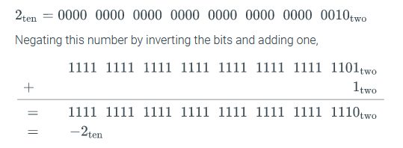
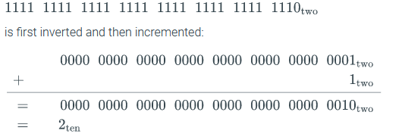
1’s complement and 2’s complement example
Example 1
Binary representation of 2 in 32 bits
Binary representation of 1’s complement of number 2 in 32 bits
Binary representation of 2’s complement of number 2 in 32 bits, which is -2
Example 2
Binary representation of -2 in 32 bits
Binary representation of 1’s complement of number 2 in 32 bits
Binary representation of 2’s complement of number -2 in 32 bits, which is 2

Slide 14
MIPS instruction format
Instruction format: A form of representation of an instruction composed of fields of binary numbers.
A R-type or Register-type MIPS instruction format is given below:
The meaning of each name of the fields in MIPS instructions is given below:
op : Basic operation of the instruction, traditionally called the opcode.
rs: The first register source operand.
rt: The second register source operand.
rd: The register destination operand. It gets the result of the operation.
shamt: Shift amount. (COD Section 2.6 (Logical operations) explains shift instructions and this term; it will not be used until then, and hence the field contains zero in this section.)
funct: Function. This field, often called the function code, selects the specific variant of the operation in the op field.

Slide 15
Translating a MIPS Assembly Instruction into a Machine Instruction
Example for R-type instruction :
Refer 2.5.1 participation activity in zybooks
Instruction Function
add rd, rs, rt 100000
addu rd, rs, rt 100001
and rd, rs, rt 100100
break 001101
div rs, rt 011010
divu rs, rt 011011
mult rs, rt 011000
multu rs, rt 011001
nor rd, rs, rt 100111
or rd, rs, rt 100101
sll rd, rt, sa 000000
Instruction Function
(Set on less than) slt rd, rs, rt 101010
sltu rd, rs, rt 101011
(shift right arithmetic) sra rd, rt, sa 000011
srl rd, rt, sa 000010
sub rd, rs, rt 100010
subu rd, rs, rt 100011
(system call) syscall 001100
xor rd, rs, rt 100110
sla MIPS instruction?

Slide 16
I-type or Immediate-type MIPS instruction format:
I-type (for immediate) or I-format and is used by the immediate and data transfer instruction
The meaning of each name of the fields in MIPS instructions is given below:
op : Basic operation of the instruction, traditionally called the opcode.
rs: The first register source operand.
rt: The second register source operand.
constant or address: The 16-bit address means a load word instruction can load any word within a region of ±215 or 32,768 bytes (±213 or 8192 words) of the address in the base register rs.

Slide 17
Example for I type instruction format
lw opcode refers to load word
35 ( for lw) | 19 (for $s3) | 8 (for $t0) | 32
Opcode
(6 bits)
rs
(5 bits)
rt
(5 bits)
constant or address
(16 bits)
Explanation:
Note that the meaning of the rt field has changed for this instruction.
In a load word instruction, the rt field specifies the destination register, which receives the result of the load.
A destination register is a register that receives the result of an operation.

Slide 18
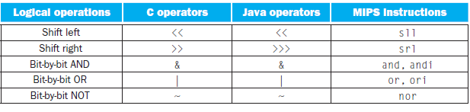
Logical operations

Slide 19
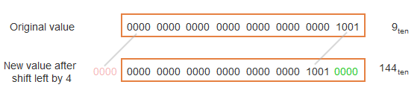
Logical mips instructions
The below instruction performs shift left logical (sll)
The above instruction shifts the contents of register $s0 by 4 bits and the result is stored in register $t2.
sll $t2,$s0,4 # reg $t2 = reg $s0 << 4 bits
Example to show sll (shift left logical) instruction:

Slide 20
AND logical operation :
Bit - by- bit operation that leaves a 1 in the result only if both bits of the operands are 1.
MIPS instruction to perform logical AND operation could be written as,
For example,
if register $t2 contains
and if register $t1 contains
After executing the MIPS instruction given above,
the value of register $t0 would be
and $t0,$t1,$t2 # reg $t0 = reg $t1 & reg $t2
0000 0000 0000 0000 0000 1101 1100 0000
0000 0000 0000 0000 0011 1100 0000 0000
0000 0000 0000 0000 0000 1100 0000 0000

Slide 21
Logical OR operation:
It is a bit-by-bit operation that places a 1 in the result if either operand bit is a 1.
The MIPS instruction format to show OR logical operation is given as,
or $t0,$t1,$t2 # reg $t0 = reg $t1 | reg $t2
Logical NOT operation :
This operation NOT takes one operand and places a 1 in the result if one operand bit is a 0, and vice versa.
The designers of MIPS decided to include the instruction NOR (NOT OR) instead of NOT.
MIPS instruction format for the NOR logical operation is given as,
nor $t0,$t1,$t3 # reg $t0 = ~ (reg $t1 | reg $t3)

Slide 22
Instructions for making decisions
beq stands for branch if equal
Conditional branches:
1. Branch if equal:
- This instruction is written as,
- This instruction means go to the statement labeled L1 if the value in register1 equals the value in register2.
2. Branch if not equal:
- This instruction is written as,
- This instruction means go to the statement labeled L1 if the value in register1 does not equal the value in register2.
beq register1, register2, L1
Conditional branch: An instruction that requires the comparison of two values and that allows for a subsequent transfer of control to a new address in the program based on the outcome of the comparison.
bne stands for branch if not equal
bne register1, register2, L1

Slide 23
Instructions to make comparisons
Comparisons between register values is accomplished in MIPS assembly language by the following instruction,
The above instruction compares two registers namely, s3 and s4. A third register t0 is set to 1 if s3 < s4.
otherwise, t0is set to 0.
Constant operands are popular in comparisons, so there is an immediate version of the set on less than instruction.
To test if register $s2 is less than the constant 10, we can just write
slt $t0, $s3, $s4 # $t0 = 1 if $s3 < $s4
slt stands for set less than
slti $t0, $s2, 10 # $t0 = 1 if $s2 < 10
slti stands for set less than immediate

Slide 24
Supporting procedures in computer hardware
Procedure: A stored subroutine that performs a specific task based on the parameters with which it is provided.
Jump-and-link instruction: An instruction that jumps to an address and simultaneously saves the address of the following instruction in a register ($ra in MIPS).
Return address: A link to the calling site that allows a procedure to return to the proper address; in MIPS it is stored in register $ra.
Jump register instruction (jr) : This instruction makes an unconditional jump to the address specified in a register.
The jump register instruction jumps to the address stored in register $ra.
Program counter (PC): The register containing the address of the instruction in the program being executed.
The jal instruction actually saves PC + 4 in register $ra to link to the following instruction to set up the procedure return.
jr $ra

Slide 25
MIPS addressing for 32-bit immediates and addresses
load upper immediate (lui) :
This instruction sets the upper 16 bits of a constant in a register, allowing a subsequent instruction to specify the lower 16 bits of the constant.
lui $t0, 255 # $t0 is register 8
lui is an instruction of I-type format. The instruction format of lui is given below.
opcode | rs | rt | Immediate or constant
6 bits
5 bits
5 bits
16 bits
Loading a 32-Bit Constant :
What is the MIPS assembly code to load this 32-bit constant into register $s0?
0000 0000 0011 1101 0000 1001 0000 0000
- First, we would load the upper 16 bits, which is 61 in decimal, using lui:
lui $s0, 61 # 61 decimal = 0000 0000 0011 1101 binary
- The value of register $s0 afterward is
0000 0000 0011 1101 0000 0000 0000 0000
- The next step is to insert the lower 16 bits, whose decimal value is 2304:
ori $s0, $s0, 2304 # 2304 decimal = 0000 1001 0000 0000
- The final value in register $s0 is the desired value:
0000 0000 0011 1101 0000 1001 0000 0000

Slide 26
Addressing mode: One of several addressing regimes delimited by their varied use of operands and/or addresses.
MIPS addressing mode summary :
Multiple forms of addressing are generically called addressing modes. The figure below shows how operands are identified for each addressing mode.
The MIPS addressing modes are the following:
- Immediate addressing: The operand is a constant within the instruction itself
- Register addressing: The operand is a register
- Base addressing / displacement addressing: The operand is at the memory location whose address is the sum of a register and a constant in the instruction
- PC-relative addressing: The branch address is the sum of the PC and a constant in the instruction
- Pseudo-direct addressing: The jump address is the 26 bits of the instruction concatenated with the upper bits of the PC
Refer 2.10.1 in zybooks for the explanation about these addressing modes

Slide 27
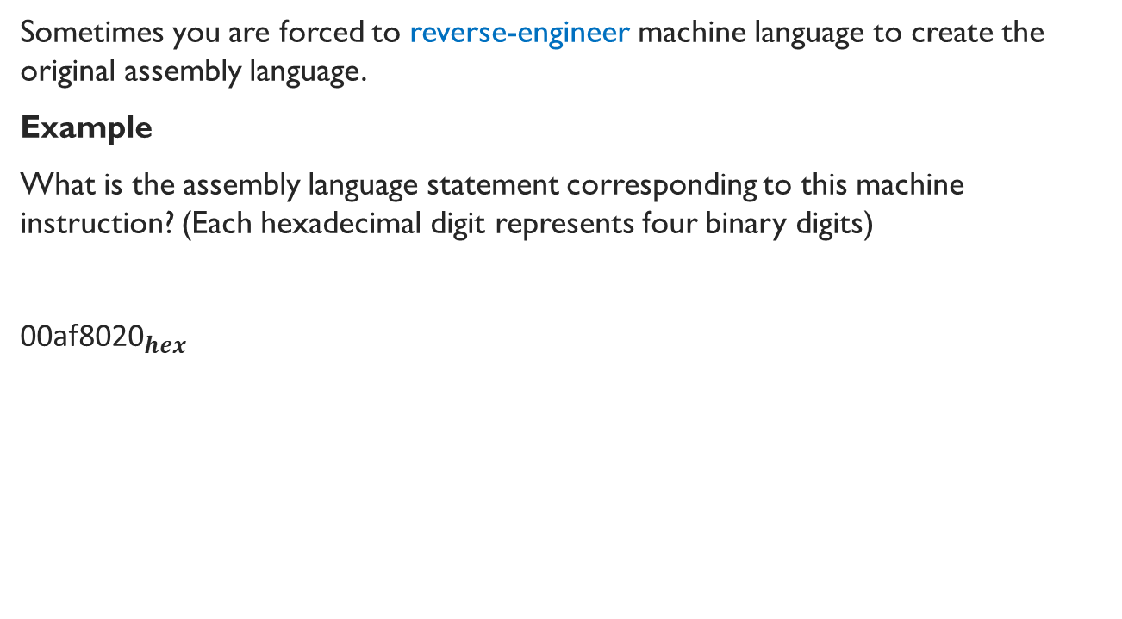
Decoding Machine Language
Sometimes you are forced to reverse-engineer machine language to create the original assembly language.
Example
What is the assembly language statement corresponding to this machine instruction? (Each hexadecimal digit represents four binary digits)
${\text{00}\text{af}\text{8020}}_{hex}$
0 | 0 | 0 | 0 | 0 | 0 | 0 | 0 | 1 | 0 | 1 | 0 | 1 | 1 | 1 | 1 | 1 | 0 | 0 | 0 | 0 | 0 | 0 | 0 | 0 | 0 | 1 | 0 | 0 | 0 | 0 | 0
binary

Slide 28
Decoding Machine Language
0 | 0 | 0 | 0 | 0 | 0 | 0 | 0 | 1 | 0 | 1 | 0 | 1 | 1 | 1 | 1 | 1 | 0 | 0 | 0 | 0 | 0 | 0 | 0 | 0 | 0 | 1 | 0 | 0 | 0 | 0 | 0
binary
op (6 bits)
0
rs (5 bits)
5
rt (5 bits)
15
rd (5 bits)
16
Not used
funct (6 bits)
32
Check op (first 6 bits), it is 0
According to Figure A.10.2, this operation has function code
Check funct (last 6 bits), it is 32
According to the Figure A.10.2, the operation is add
It is a R type instruction
Check rs, rt, rd, shamt respectively
add $s0, $a1, $t7

Slide 29
Encoding and Decoding Machine Language
Example
Translate the following machine code to assembly code
1 | 0 | 1 | 0 | 1 | 1 | 1 | 1 | 1 | 0 | 1 | 1 | 1 | 1 | 1 | 1 | 0 | 0 | 0 | 0 | 0 | 0 | 0 | 0 | 0 | 0 | 0 | 0 | 0 | 1 | 0 | 0
binary
op (6 bits)
43
rs (5 bits)
29
rt (5 bits)
31
constant (16 bits)
4
sw $ra, 4($sp)
Notes:
Do it on the board

Slide 30
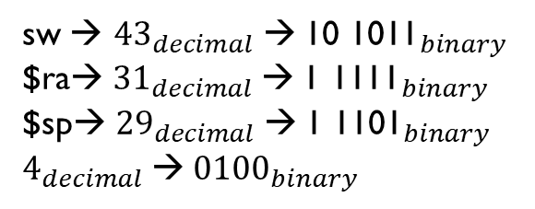
Encoding and Decoding Machine Language
Example
Translate the following assembly code to machine code
sw $ra,4($sp)
sw → ${43}_{decimal}$ →${ \text{10 1011}}_{binary}$
$ra→ ${31}_{decimal}$→${ \text{1 1111}}_{binary}$
$sp→ ${29}_{decimal}$→${ \text{1 1101}}_{binary}$
$4_{decimal}$→${\text{ 0100}}_{binary}$
101011 | 11101 | 11111 | 0000 0000 0000 0100
op (6 bits) | rs (5 bits) | rt (5 bits) | constant (16bits)

Slide 31

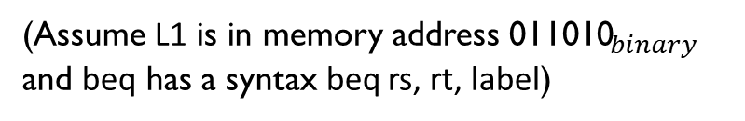
Encoding and Decoding Machine Language
Exercise / Assignment 2
Translate the following machine code to assembly code ( Refer slides 27 and 28 in this chapter to solve this question)
2) Translate the following assembly code to machine code (Refer slide #30 to solve this question)
$${\text{28880002}}_{hex}$$
beq $t0, $s1, L1
(Assume L1 is in memory address ${\text{011010}}_{binary}$
and beq has a syntax beq rs, rt, label)
Opcode for beq is 000100

